Slide 1
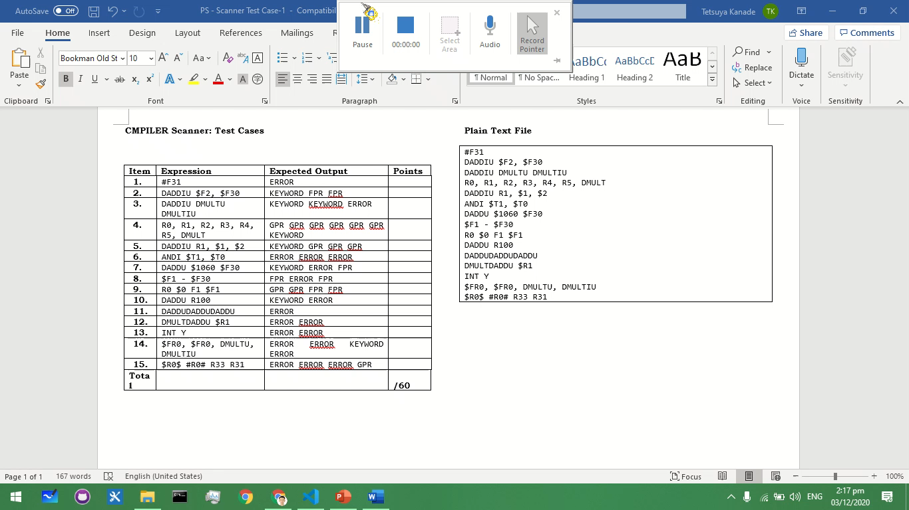
Xu, Aaron John S.
S 12

Slide 2
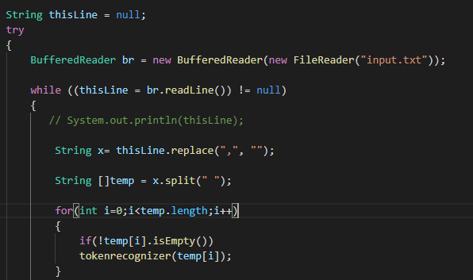
▪ Reading the text input.
Use BufferedReader
For each line replace commas with nothing
Split the text on whitespaces
Upon optimizing the code I realized that I don’t need to keep tabs on the tokens, so what I did was to convert the tokens straight into MIPS64 Lexical Rules (KEYWORDS, FPR, GPR, and Error), to save memory.
If I need to keep tabs on the tokens I would just need to save it into another arraylist, and manipulate it from there.

Slide 3
Maximal Munch Algorithm
1st delimiter is backslash n (“\n”), used BufferedReader to take that into account.
2nd delimiter is comma (“,”), used .replace(“,”, “”) to take that into account.
3rd delimiter is whitespace (“ “), used .split(“ ”) to take that into account.
Each words from a line will be saved into an array, which I later on manipulated to get the results (GPR, FPR, KEYWORD, and ERROR)
Notes:
Maximal munch
Add to queue until a delimiter
1st delimiter is backslash n (“\n”), used BufferedReader to take that into account.
2nd delimiter is comma (“,”), used .replace(“,”, “”) to take that into account.
3rd delimiter is whitespace (“ “), used .split(“ ”) to take that into account.
By using BufferedReader I am sure that the program will only read the input line per line.
By replacing the commas into nothing, I still retained the delimiter whitespace.
By using the .split method on the whitespaces, I can ensure that the program will always take the longest possible string to be identified as GPR, FPR, KEYWORD, and ERROR.

Slide 4
Regex
GPR: [R|$](3[0-1]|[1-2][0-9]|[0-9])
FPR: [$]?F(3[01]|[12][0-9]|[0-9])
KEYWORD: D((ADD)(I?U)|(MULTU?))

Slide 5
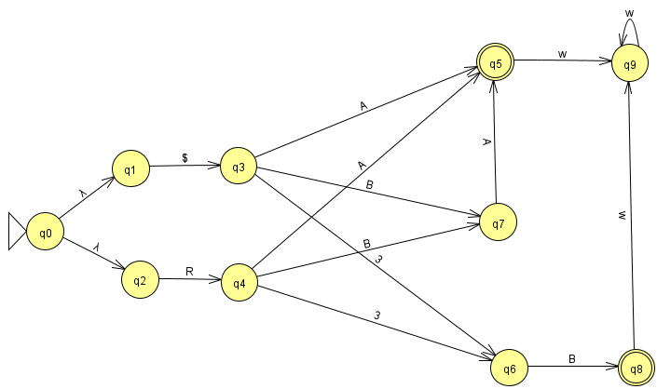
NFA (GPR)
Legends:
$ = $
R = R
A = [0-9]
B = [1-2]
C = [0-1]
W = any input

Slide 6
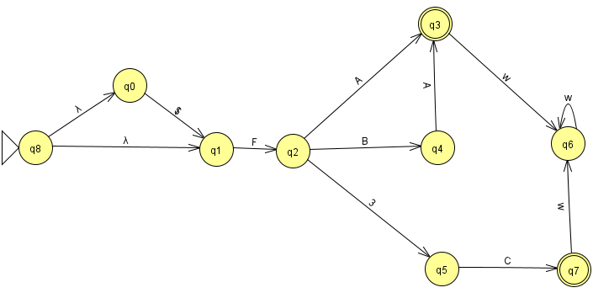
NFA (FPR)
Legends:
$ = $
F = F
3 = 3
A = [0-9]
B = [1-2]
C = [0-1]
W = any input

Slide 7
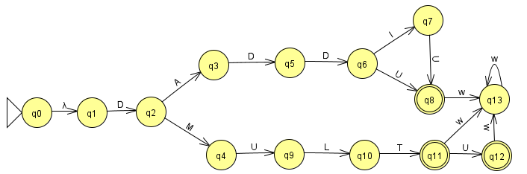
NFA (KEYWORDS)
Legends:
D = D
A = A
M = M
U = U
I = I
L = L
T = T
W = any input

Slide 8
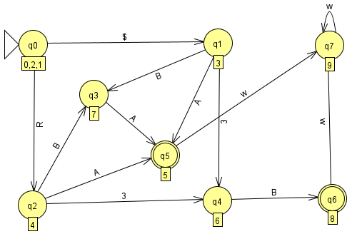
DFA(GPR)
Legends:
$ = $
R = R
A = [0-9]
B = [1-2]
C = [0-1]
W = any input

Slide 9
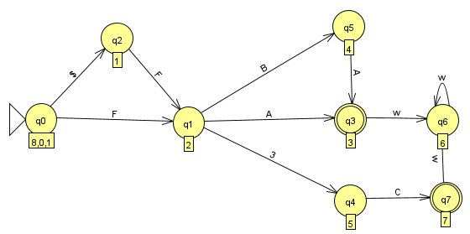
DFA (FPR)
Legends:
$ = $
F = F
3 = 3
A = [0-9]
B = [1-2]
C = [0-1]
W = any input

Slide 10
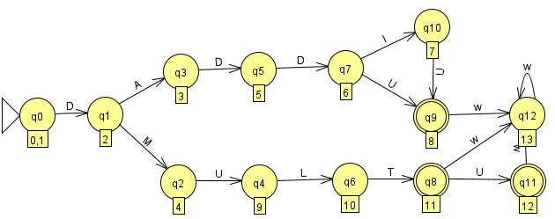
DFA (KEYWORDS)
Legends:
D = D
A = A
M = M
U = U
I = I
L = L
T = T
W = any input

Slide 11
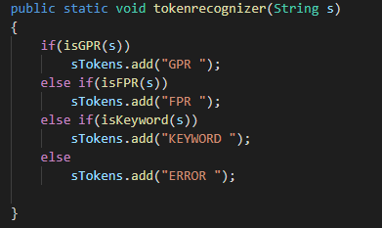
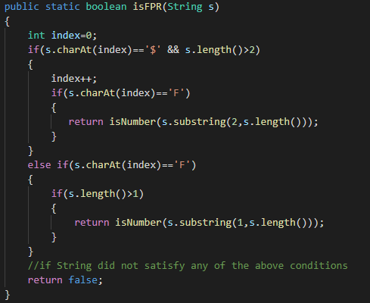
Unrecognizable Tokens (Error)
If it didn’t reach a final state or exceed the final state then it will be considered as Unrecognizable Tokens.
Code Wise, would return false if a pattern did not satisfy any of the conditions set.
If it is not a GPR,FPR and KEYWORD then the token is an ERROR.

Slide 12
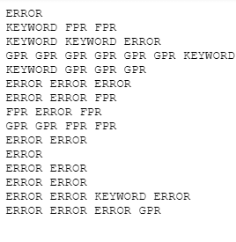
Output

Slide 13
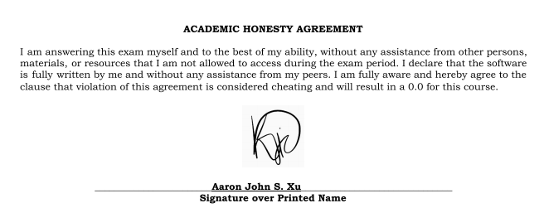
Academic Honesty Agreement

